Slide 1
Lesson 7: Thermal and Mechanical Element Math Models in Control Systems
ET 438a
Automatic Control Systems Technology

Slide 2
Learning Objectives
After this presentation you will be able to:
Explain how heat flows from conduction and convection in a thermal system.
Compute thermal resistance and determine heat flow.
Determine thermal capacitance.
Determine the mechanical resistance, capacitance and dead-time delay in a mechanical system.

Slide 3
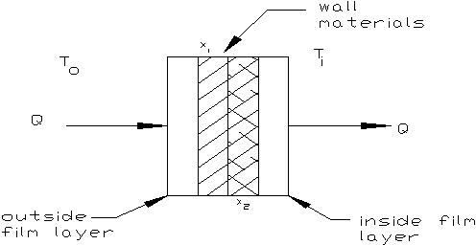
Thermal Elements In Control Systems
Thermal Conduction and Convection
Thermal Resistance - opposition to heat flow. Heat flows from high temperature to low temperature.
Watts
R_{u} = unit thermal resistance
R_{T}
Heat transfer by convection & conduction through R_{T}

Slide 4
Thermal Conduction and Convection
Resistance of film layers depends on type of fluid, velocity of fluid. High velocity flow makes thin film. Convection cooling., “wind chill“ effect.
Film conductance
is called film coefficient

Slide 5
Thermal Conduction and Convection
The natural convection in air formulas
Horizontal surface facing up
T_{d} = temperature difference between wall and fluid
Vertical surfaces
Horizontal surface facing down

Slide 6
Thermal Conduction and Convection
Natural and Forced Convection
Natural convection in still water
Where: T_{w} = water temperature
Forced convection-air against smooth surfaces and inside pipes.
Where: v_{air} = velocity of air flow.

Slide 7
Thermal Conduction
Thermal resistance of inner solid layers given by
K-m²/W
Where: x_{i} = thickness of i-th material
K_{i} = thermal conductivity of material
(See appendix in text for values)
Unit resistance of a composite wall is the sum of inside and outside film resistances and the resistances comprising the wall.

Slide 8

Thermal Conduction
Series resistance analogy for thermal conduction through a composite material. Temperature analogous to voltages.

Slide 9
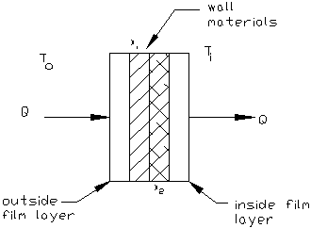
Heat Flow Example
Example 7-1: A wall section shown below has 2 layers: steel 1 cm thick, and insulation 2 cm thick. Still Water at 45 C is inside the wall. The temperature difference between the water and the inner wall is estimated to be 10 C. The outer wall is surrounded by air at a temperature of 85 C that has a velocity of 6 m/s. The wall dimensions are 2 m x 3 m. Determine the unit thermal resistance, the total thermal resistance, the total heat flow, the direction of heat flow.
Insulation
Steel
Air
85 C
V_{air} =6 m/s
Still water inside
45 C

Slide 10
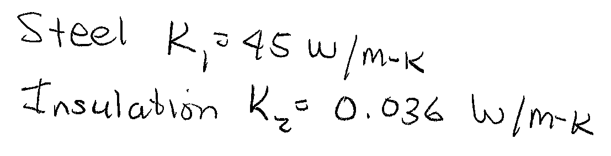
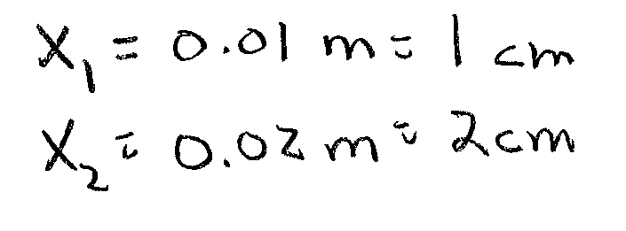
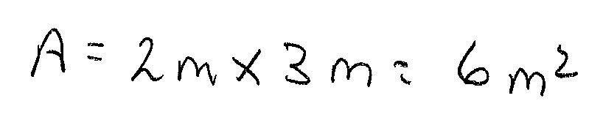
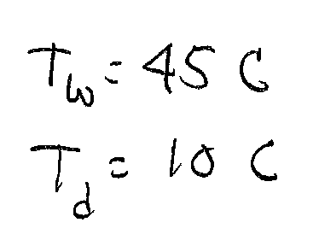
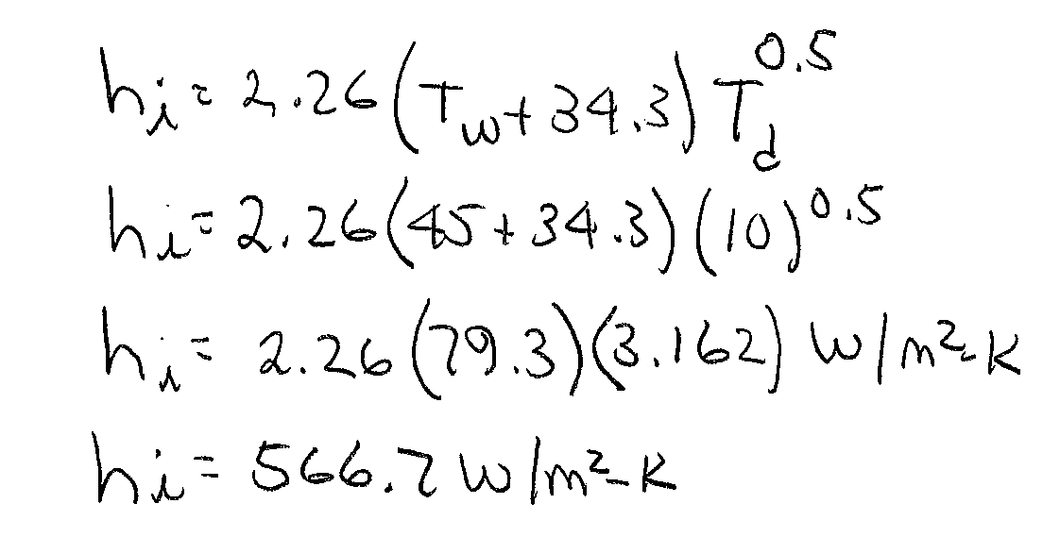
Heat Flow Example Solution (1)
Find K₁ and K₂ from the Appendix A of the textbook
Inside film coefficient is for still water

Slide 11
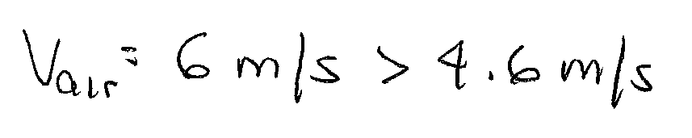
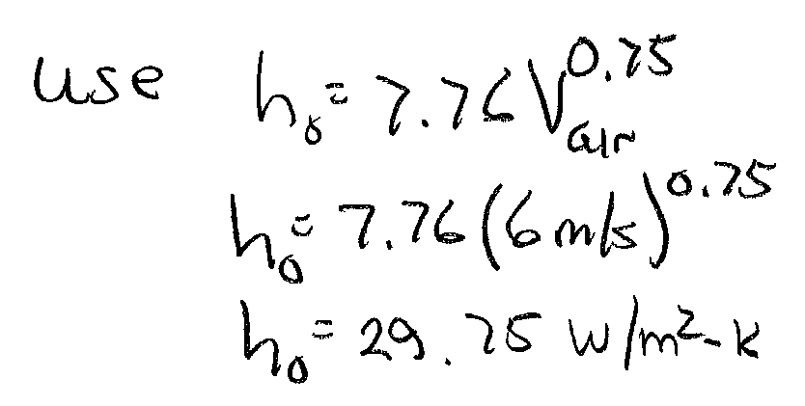
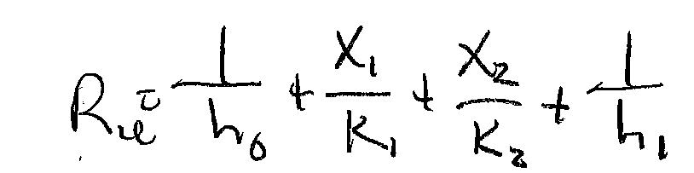
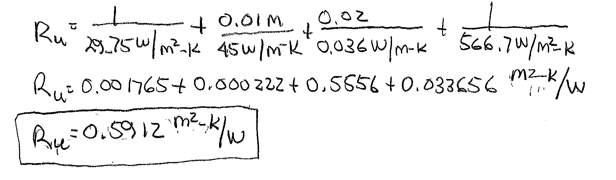
Heat Flow Example Solution (2)
Outside film coefficient is for force air convection
ANS

Slide 12
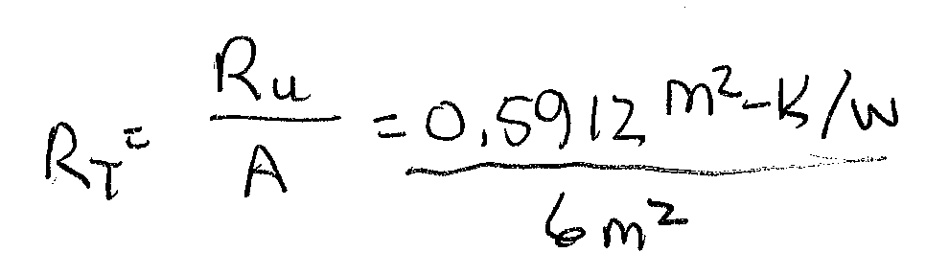

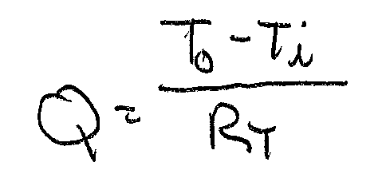
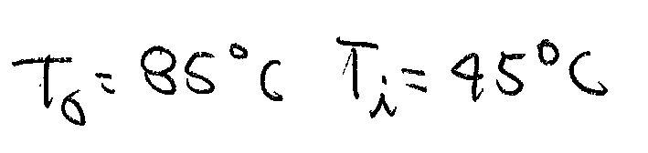
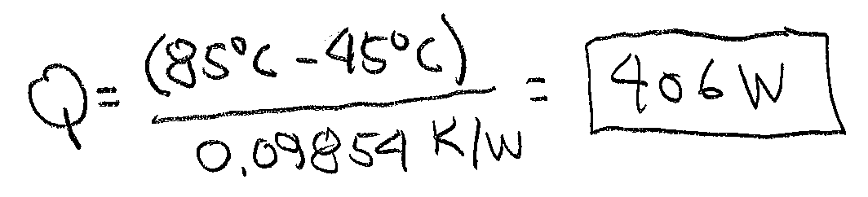
Heat Flow Example Solution (3)
Now compute the total thermal resistance and the heat flow
Compute heat flow
ANS
Note: No need to convert degrees C to K since we are taking the different of two
Temperatures.

Slide 13
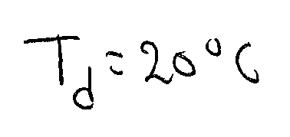
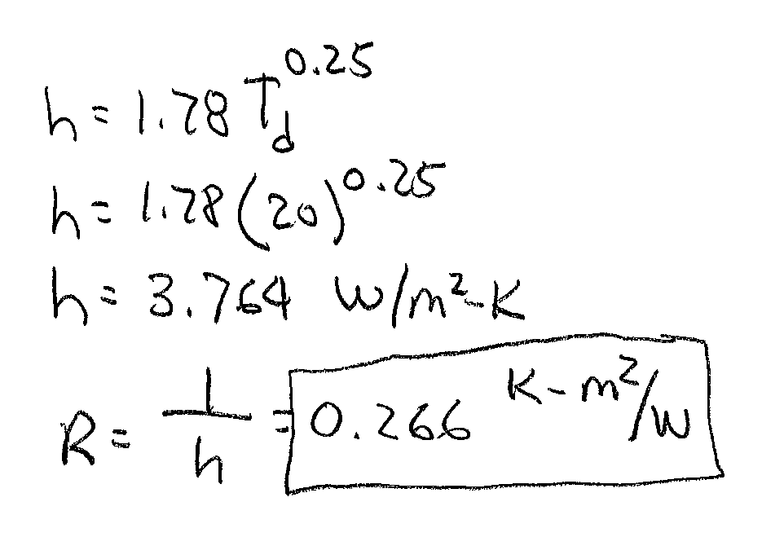
Convection Calculation Example
Example 7-2: Determine the thermal resistance for each of the following film conditions: a.) Natural convection in still air of vertical surface T_{d} = 20 C. b.) natural convection in still water where T_{d} = 30 C and T_{w} is 20 C
c.) forced convection of air with velocity of 4 m/s.
a.) Natural convection in still air of vertical surface
ANS

Slide 14
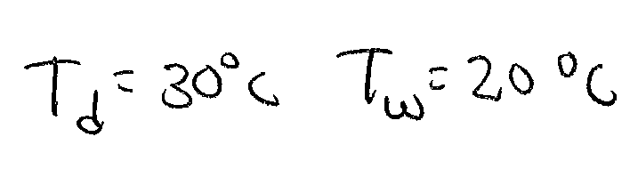
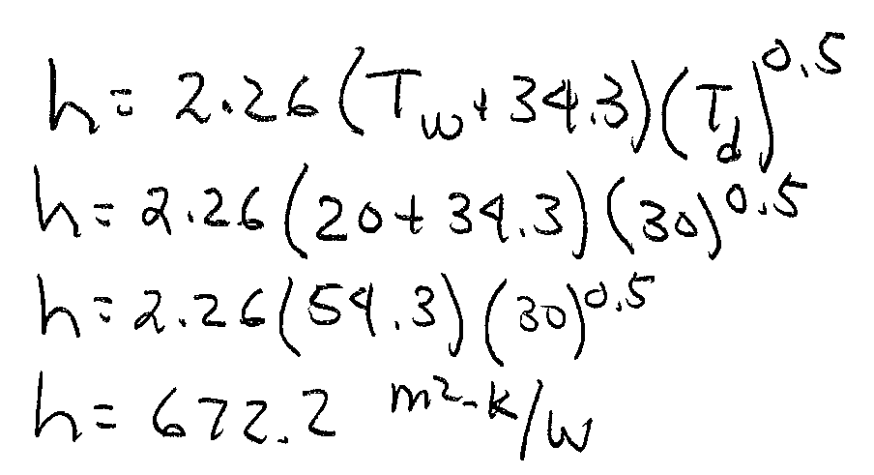
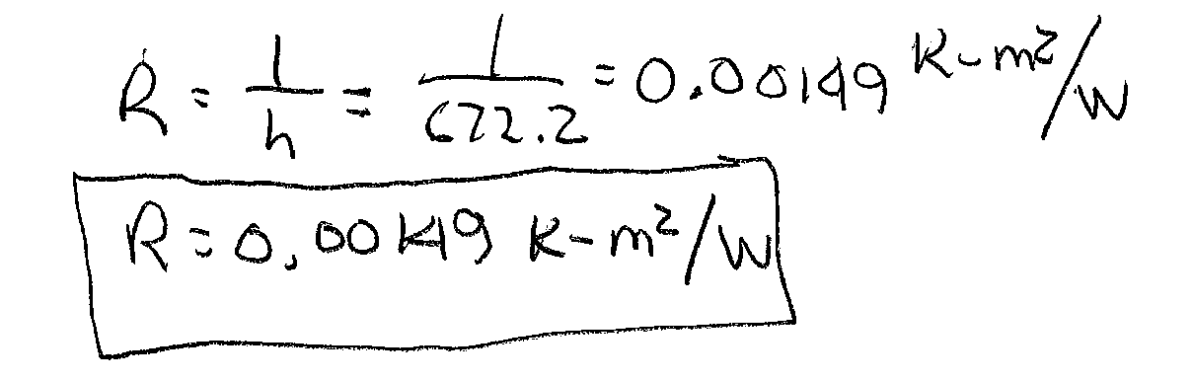
Example 7-2 Solution (2)
b.) Natural convection in still water

Slide 15
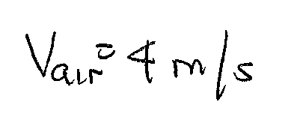
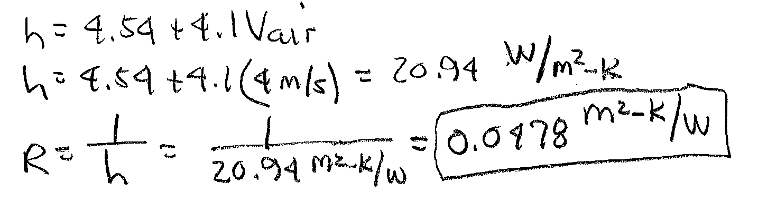
Example 7-2 Solution (3)
c.) forced convection of air with velocity of 4 m/s

Slide 16
Thermal Capacitance (Heat Capacity)
Thermal Capacitance - increase in heat required to make a unit change in temperature (SI unit J/K)
Heat Capacity (specific heat) - heat required to raise temperature of 1 kg of material by 1 K.
Where: C_{T} = thermal capacitance
m = mass (kg)
S_{T} = heat capacity (J/kg)

Slide 17
Thermal Capacitance Example
Example 7-3: An insulated water storage tank shown below has a diameter of 1.219 m and is filled to a height of 2.438 m. Determine the thermal capacitance, C_{T}, of the water in the tank. Also determine the tank liquid capacitance, C_{L}.
1.219 m
Find the mass of water in the tank by using the tank volume
and the density of water
2.438 m

Slide 18
Example 7-3 Solution (1)
Now find the thermal capacitance
ANS
Compute the liquid capacitance
ANS

Slide 19
Characteristics of Mechanical Elements
Mechanical Resistance = Friction. Opposition to motion. Force required to increase velocity.
Types of Friction
Viscous Friction
Coulomb Friction
Friction of motion. Related to velocity.
Force independent
of velocity

Slide 20
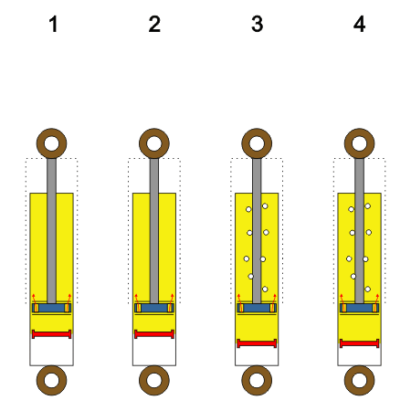
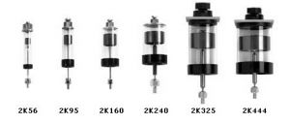
Characteristics of Mechanical Elements
Examples of viscous friction - shock absorber, dash pot
Linear viscous friction
Non-linear viscous friction
At operating point, use tangent line to find approximate B

Slide 21
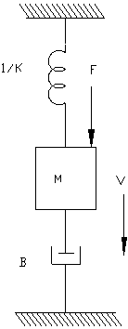
Mechanical Energy Storage
Mechanical Capacitance - change in length of spring required to make unit increase in force. Inverse spring constant
Mechanical inertia - force required to make unit increase in acceleration. Proportional to mass.
F

Slide 22
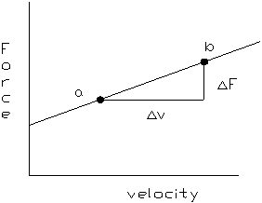
Mechanical Delay
Mechanical Dead-Time - time required to transport material from one place to another.
Where: D = distance material covers
v = velocity of material
Example 7-4: A mechanical system consists of a sliding load and a shock absorber. The force versus velocity curve is shown below. Find R_{m} and coulomb friction, F_{c}.
Run | Force=F (N) | Velocity=v (m/s)
a | 7.1 | 10.5
b | 9.6 | 15.75

Slide 23
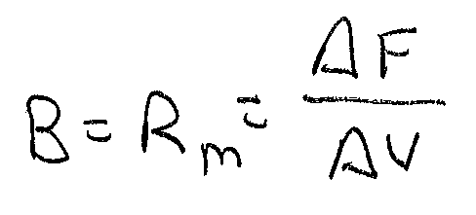
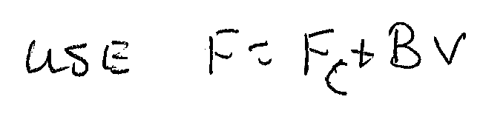
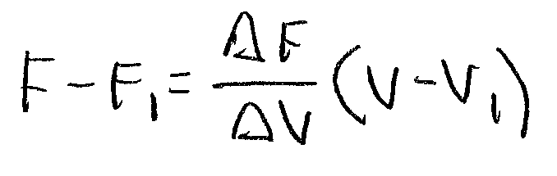
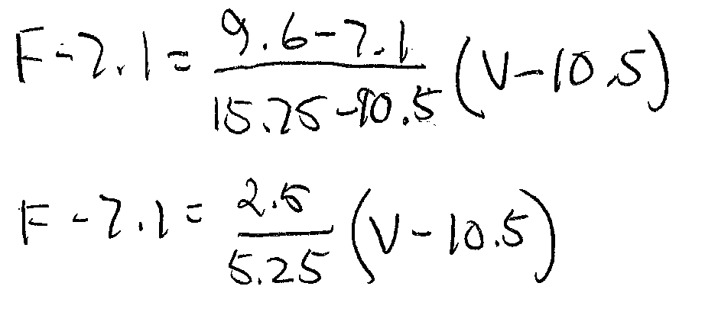
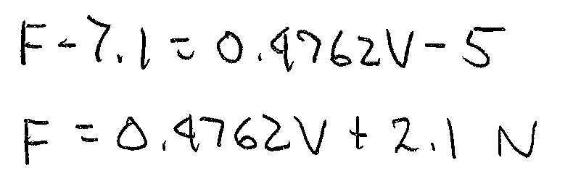
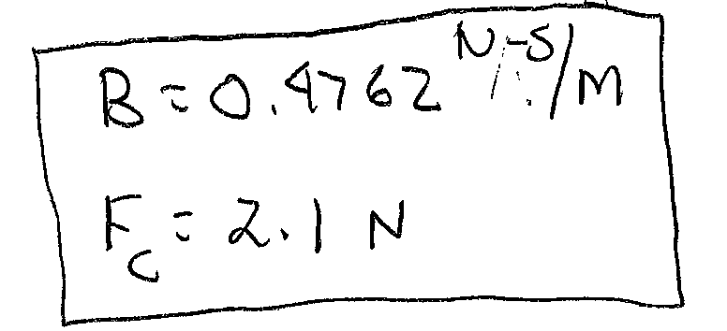
Example 7-4 Solution
Use the point-slope form of the line
F₁=7.1 N v₁=10.5 m/s
ANS

Slide 24
End Lesson 7: Thermal & Mechanical Models in Control Systems
ET 438a
Automatic Control Systems Technology

